Slide 1

#LifeKoKaroLift
Foundations of Programming Program

Slide 2


Course : Foundations of Programming Program
Lecture On : String,Arrays and Exception
Instructor : Shubham Sharma

Slide 3



Poll 1
Assume a class MainClass with only following method
public static void main(String x){
}
This would lead to a :
Compiler Error
Runtime Exception
Neither Compilation nor Runtime Error
No output(but code will run fine)
Practice in teams of 4 students
Industry expert mentoring to learn better
Get personalised feedback for improvements
11/09/19
11

Slide 4
Poll 1
Assume a class MainClass with only following method
public static void main(String x){
}
This would lead to a :
Compiler Error
Runtime Exception
Neither Compilation nor Runtime Error
No output(but code will run fine)
Practice in teams of 4 students
Industry expert mentoring to learn better
Get personalised feedback for improvements
11/09/19
11

Slide 5
Poll 1
Which of the following method body will change value of Employee reference in caller method :
Declaration : public static void changeEmployee(Employee e){
--------------------- //???
} :
e=null;
e=new Employee();
Any setter method that would change anything in employee object referred by e
Any setter method that would change anything in employee object referred by e
Practice in teams of 4 students
Industry expert mentoring to learn better
Get personalised feedback for improvements
11/09/19
11

Slide 6
Poll 1
Which of the following method body will change value of Employee reference in caller method :
Declaration : public static void changeEmployee(Employee e){
--------------------- //???
} :
e=null;
e=new Employee();
Any setter method that would change anything in employee object referred by e
Any getter method that would access anything in employee object referred by e
Practice in teams of 4 students
Industry expert mentoring to learn better
Get personalised feedback for improvements
11/09/19
11

Slide 7
Poll 1
Number of objects created by following lines of code are:
String str1=”A”;
String str2=str1;
String str3=new String(“B”);
String str4=str1.concat(“K”).concat(“A”);
4
8
6
5
Practice in teams of 4 students
Industry expert mentoring to learn better
Get personalised feedback for improvements
11/09/19
11

Slide 8
Poll 1
Number of objects created by following lines of code are:
String str1=”A”;
String str2=str1;
String str3=new String(“B”);
String str4=str1.concat(“K”).concat(“A”);
4
8
6
5
Practice in teams of 4 students
Industry expert mentoring to learn better
Get personalised feedback for improvements
11/09/19
11

Slide 9
Today’s Agenda
1
Strings and Arrays
2
Exceptions
3
Inbuilt Functions and Basic File I/O

Slide 10
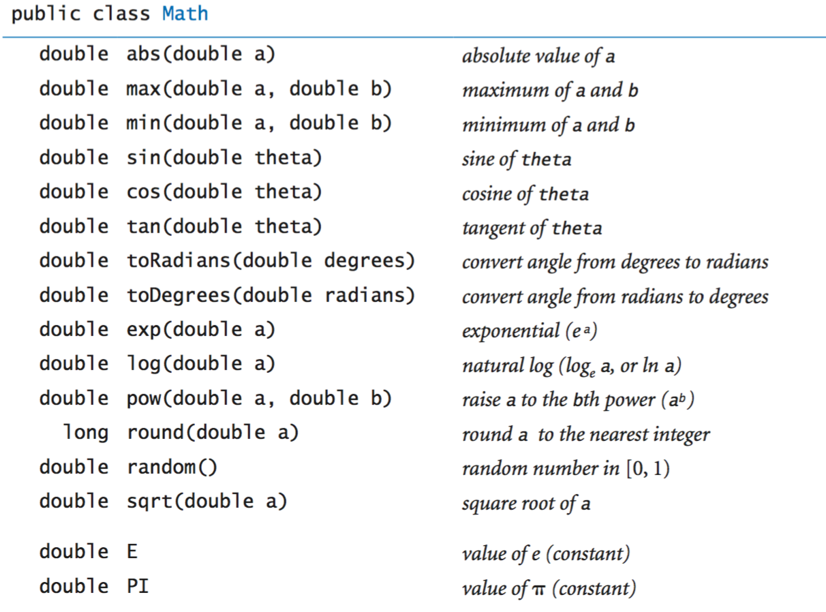
Math methods in Java

Slide 11
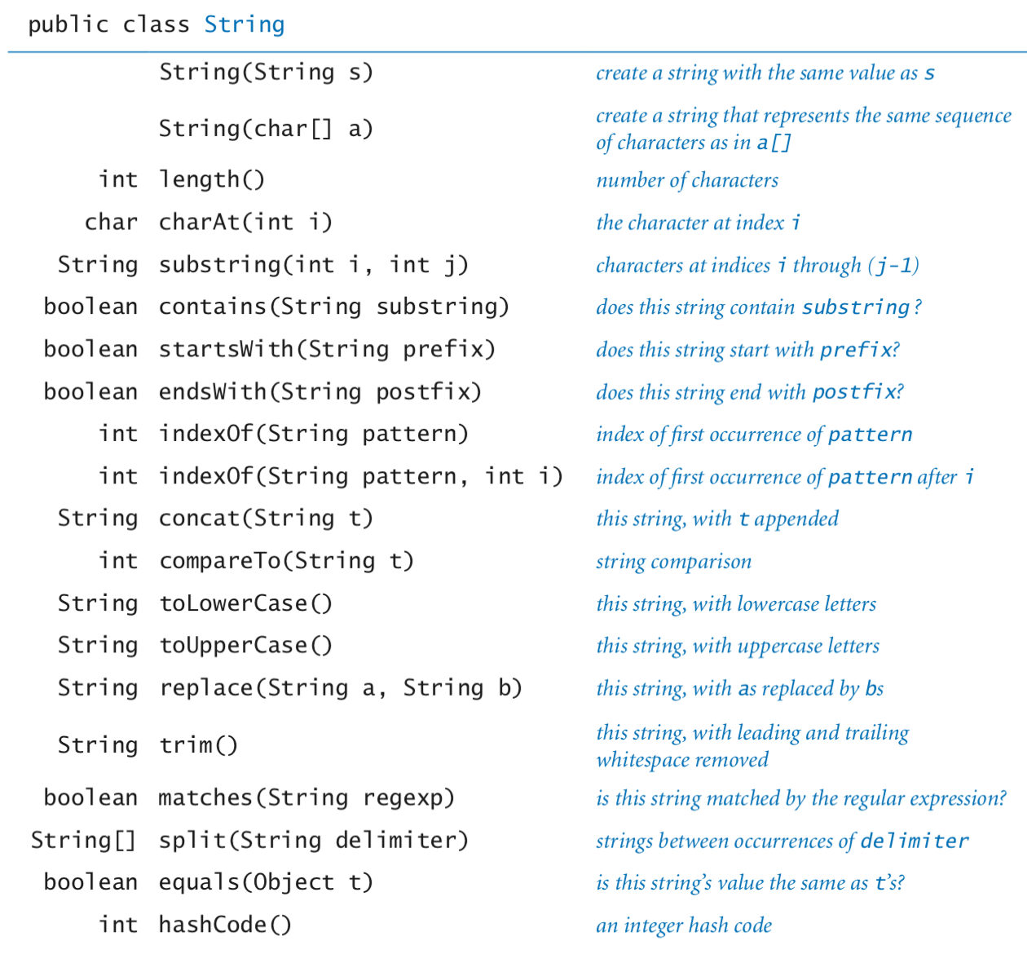
String methods in Java

Slide 12
Poll 2
To report an exception by a method, which is not handled by the method itself we use
throw
throws
try
finally
Practice in teams of 4 students
Industry expert mentoring to learn better
Get personalised feedback for improvements
11/09/19
11

Slide 13
Poll 2
To report an exception by a method, which is not handled by the method itself we use
throw
throws
try
finally
Practice in teams of 4 students
Industry expert mentoring to learn better
Get personalised feedback for improvements
11/09/19
11

Slide 14
Poll 2
Which of the following array declaration is illegal :
int[] arr[];
int[5] arr;
int[][] arr[];
int[] arr={10,5,16,19};
Practice in teams of 4 students
Industry expert mentoring to learn better
Get personalised feedback for improvements
11/09/19
11

Slide 15
Poll 2
Which of the following array declaration is illegal :
int[] arr[];
int[5] arr;
int[][] arr[];
int[] arr={10,5,16,19};
Practice in teams of 4 students
Industry expert mentoring to learn better
Get personalised feedback for improvements
11/09/19
11

Slide 16
Key Takeaway
1
String
2
Arrays
3
Exception

Slide 17
Next Class
1
Classes and Objects

Slide 18
#LifeKoKaroLift
Thank You!

